Slide 2

Angular Routing & Navigation

Slide 3
Agenda
What is Routing
Route Module
Components in Router Module
Configure Router
Navigation
Router Guards
Lazy Loading using routes

Slide 4
Angular – Routing
Routing allows to move from one part of the application to another part or one View to another View.

Slide 5
Angular – Route Module
The Router is a separate module in Angular. It is in its own library package, @angular/router. The Router Module provides the necessary service providers and directives for navigating through application views.
Using Angular Router:
Navigate to a specific view by typing a URL in the address bar
Pass optional parameters to the View
Bind the clickable elements to the View and load the view when the user performs application tasks
Handles back and forward buttons of the browser
Allows to dynamically load the view
Protect the routes from unauthorized users using Guards

Slide 6
Angular – Components in Router Module
Router
The Angular Router is an object that enables navigation from one component to the next component as users perform application tasks like clicking on menus links, buttons or clicking on back/forward button on the browser. We can access the router object and use its methods like navigate() or navigateByUrl(), to navigate to a route.
Route
Route tells the Angular Router which view to display when a user clicks a link or pastes a URL into the browser address bar. Every Route consists of a path and a component it is mapped to. The Router object parses and builds the final URL using the Route
Routes
Routes is an array of Route objects our application supports

Slide 7
Angular – Components in Router Module
RouterOutlet
The RouterOutlet is a directive (<router-outlet>) that serves as a placeholder, where the Router should display the view.
RouterLink
The RouterLink is a directive that binds the HTML element to a Route. Clicking on the HTML element, which is bound to a RouterLink, will result in navigation to the Route. The RouterLink may contain parameters to be passed to the route’s component.
RouterLinkActive
RouterLinkActive is a directive for adding or removing classes from an HTML element that is bound to a RouterLink. Using this directive, we can toggle CSS classes for active RouterLinks based on the current RouterState

Slide 8
Angular – Components in Router Module
ActivatedRoute
The ActivatedRoute is an object that represents the currently activated route associated with the loaded Component.
RouterState
The current state of the router including a tree of the currently activated routes together with convenience methods for traversing the route tree.
RouteLink Parameters array
The Parameters or arguments to the Route. It is an array which you can bind to RouterLink directive or pass it as an argument to the Router.navigate method.

Slide 9
Angular – Configure Router
To Configure the Router in Angular, need to follow these steps:
Set the <base href>
Define routes for the view
Register the Router Service with Routes
Map HTML Element actions to Route
Choose where to display the view

Slide 10
Angular – Configure Router
---Set the <base href>---
The HTML <base> element specifies the base URL to use for all relative URLs contained within a document.
The Angular Router uses the HTML5 style of Routing (or PathLocationStrategy) as the default option. The router makes use of the browser’s history API for navigation and URL interaction.
<base href= “/”>
To make HTML5 routing to work, we need to set up the “base href” in the DOM. This is done in app’s index.html file immediately after the head tag.

Slide 11
Angular – Configure Router
---Define the routes---
Next, create an array of route objects. Each route maps path (URL Segment) to the component.
path: The URL path segment of the route. We will use this value to refer to this route elsewhere in the app
component: The component to be loaded.
This route tells angular to render ProductComponent when the user navigate to the URL “/product”

Slide 12
Angular – Configure Router
---Register the Router ---
Import the Router Module from @angular/router library in the root module of the application.
Then, install the routes using the RouterModule.forRoot method, passing the routes as the argument in the imports array.

Slide 13

Angular – Configure Router
---Map Actions to Route---
Next, we need to bind the click event of the link, image or button to a route. This is done using the routerlink directive.
The routerLink directive accepts an array of route names along with parameters. This array is called as Link Parameters array.
When the application requests navigation to the route “product”, the router looks in the routes array and activates the instance of the component associated with the route “product”, which is ProductComponent. The browser address location & history is also updated to /product.

Slide 14

Angular – Configure Router
---Choose where to display---
Finally, we need to tell the angular where to display the view. This is done using the RouterOutlet directive as shown. We will add the following directive to the root component.

Slide 15
Angular – Navigation
We can navigate between routes in Angular 2 in two ways
Using RouterLink Directive
Via Code

Slide 16
Angular – Navigation
RouterLink Directive
The RouterLink is a directive, which you can use to bind any clickable HTML element to a Route. When the user clicks on the HTML element the router will navigate to the associated Route.
Example:
Will map to URL “/product” and renders the associated ProductComponent.

Slide 17
Angular – Navigation
Navigating using Code
We can also navigate imperatively by using the code. This is done using the router service, which provides navigate and navigatebyUrl methods via which we can perform route changes.
router.navigate
This method is to Navigate to a route using the link parameters array.
navigate.navigateByUrl
This to navigate to a URL by using the absolute path. The first argument is a string containing the complete URL.

Slide 18

Angular – Navigation
Link Parameter Array.
LINK Parameters array is an array of strings, which must specify as argument to either to routerlink directive or navigate method for navigation to work
We need to specify the path of the route and route parameters that go into the route URL.
The following example resolves to the URL path ‘/product/detail/1’
OR

Slide 19
Angular – Router Guards
We use the Angular Guards to control, whether the user can navigate to or away from the current route.
Purpose of Angular Guards
Allowing the user to navigate all parts of the application is not a good idea. We need to restrict the user until the user performs specific actions like login.
We want our App to stop the unauthorized user from accessing the protected route.

Slide 20
Angular – Router Guards
Uses of Angular Guards
To Confirm the navigational operation
Asking whether to save before moving away from a view
Allow access to certain parts of the application to specific users
Validating the route parameters before navigating to the route
Fetching some data before you display the component.

Slide 21
Angular – Router Guards
The router supports multiple guard interfaces:
CanActivate to mediate navigation to a route.
CanActivateChild to mediate navigation to a child route.
CanDeactivate to mediate navigation away from the current route.
Resolve to perform route data retrieval before route activation.
CanLoad to mediate navigation to a feature module loaded asynchronously.

Slide 22
Angular – Router Guards
CanActivate: requiring authentication
The Angular CanActivate guard decides, if a route can be activated ( or component gets rendered). We use this guard, when we want to check on some condition, before activating the component or showing it to the user. This allows us to cancel the navigation.
Use cases for the CanActivate Guard
Checking if a user has logged in
Checking if a user has permission
One of the use case of this guard is to check if the user has logged in to the system. If user has not logged in, then the guard can redirect him to login page.

Slide 23
Angular – Router Guards
CanActivateChild: guarding child routes
The CanActivatechild guard is very similar to CanActivateGuard. The key difference is that it runs before any child route is activated. We apply this guard to the parent route. The Angular invokes this guard whenever the user tris to navigate to any of its child route. This allows us check some condition and decide whether to proceed with the navigation or cancel it.

Slide 24
Angular – Router Guards
CanDeactivate: handling unsaved changes
The Angular CanDeactivate guard is called, whenever we navigate away from the route before the current component gets deactivated.
The best use case for CanDectivate guard is the data entry component. The user may have filled the data entry and tries to leave that component without saving his work. The CanDeactivate guard gives us a chance to warn the user that he has not saved his work and give him a chance to cancel the navigation.

Slide 25
Angular – Router Guards
Resolve
This guard delays the activation of the route until some tasks are complete. You can use the guard to pre-fetch the data from the backend API, before activating the route.

Slide 26
Angular – Router Guards
CanLoad Guard: guarding unauthorized loading of feature modules
The CanLoad Guard prevents the loading of the Lazy Loaded Module. We generally use this guard when we do not want to unauthorized user to navigate to any of the routes of the module and also stop then even see the source code of the module.
The Angular provides canActivate Guard, which prevents unauthorized user from accessing the route. But it does not stop the module from being downloaded. The user can use the chrome developer console to see the source code. The CanLoad Guard prevents the module from being downloaded.

Slide 27
Angular – Lazy Loading
Lazy loading is the process of loading particular features of Angular application only when user navigates to their routes for the first time. This can be very useful for increasing the application performance and decreasing the initial size of the bundle transmitted to the client browser.
To add lazy loading by asynchronously loading the feature module for routing whenever required, we go to the route configuration and use the property loadChildren. Let's have a look on syntax below:

Slide 28


Angular – Lazy Loading
Generate Feature Module using Angular CLI
We will load the below-featured module with lazy loading
Generate Component inside Feature Module
Using loadChildren to lazy load the Feature Module
Angular provides the loadChildren property of a route's path to specify the module that needs to be lazy-loaded when the user first navigated to.

Slide 29
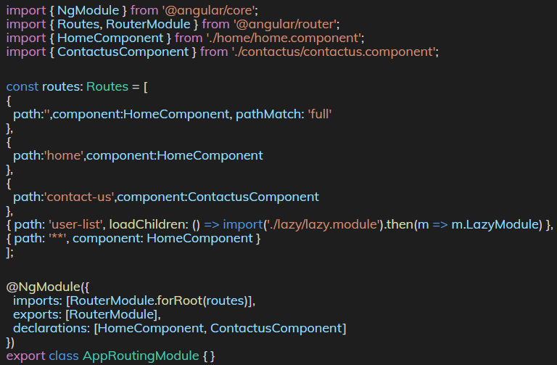
Angular – Lazy Loading
Have a look at the code of the app-routing.module.ts file.

Slide 30
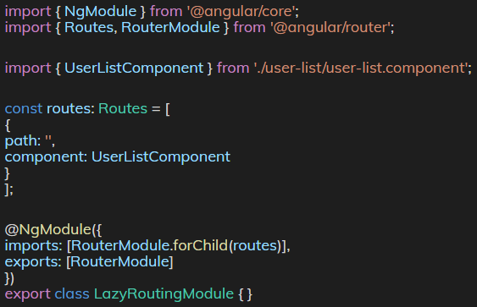
Angular – Lazy Loading
Configuring Route in Feature Module
Let's have a look on code inside lazy-routing.module.ts file.
Notes:
Don't forget to add the routing module in lazy.module.ts file.

Slide 31
THANK YOU

